Slide 1
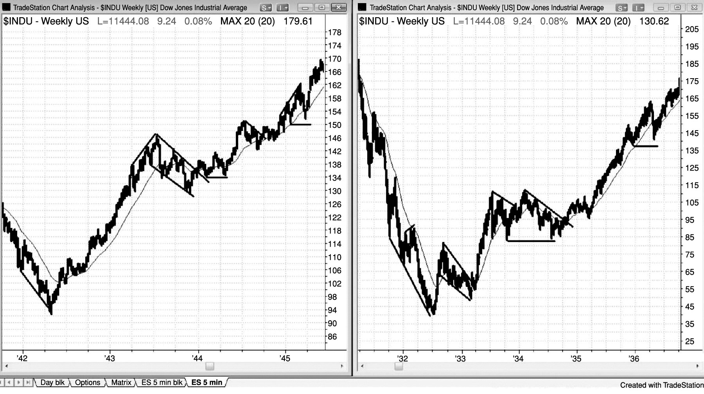
FIGURE I.1 Price Action Has Not Changed over Time

Slide 2
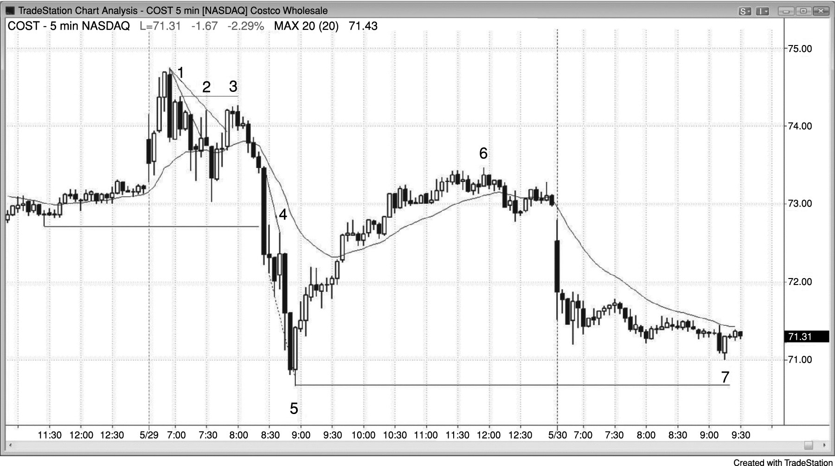
FIGURE I.2 Ignore the News

Slide 3
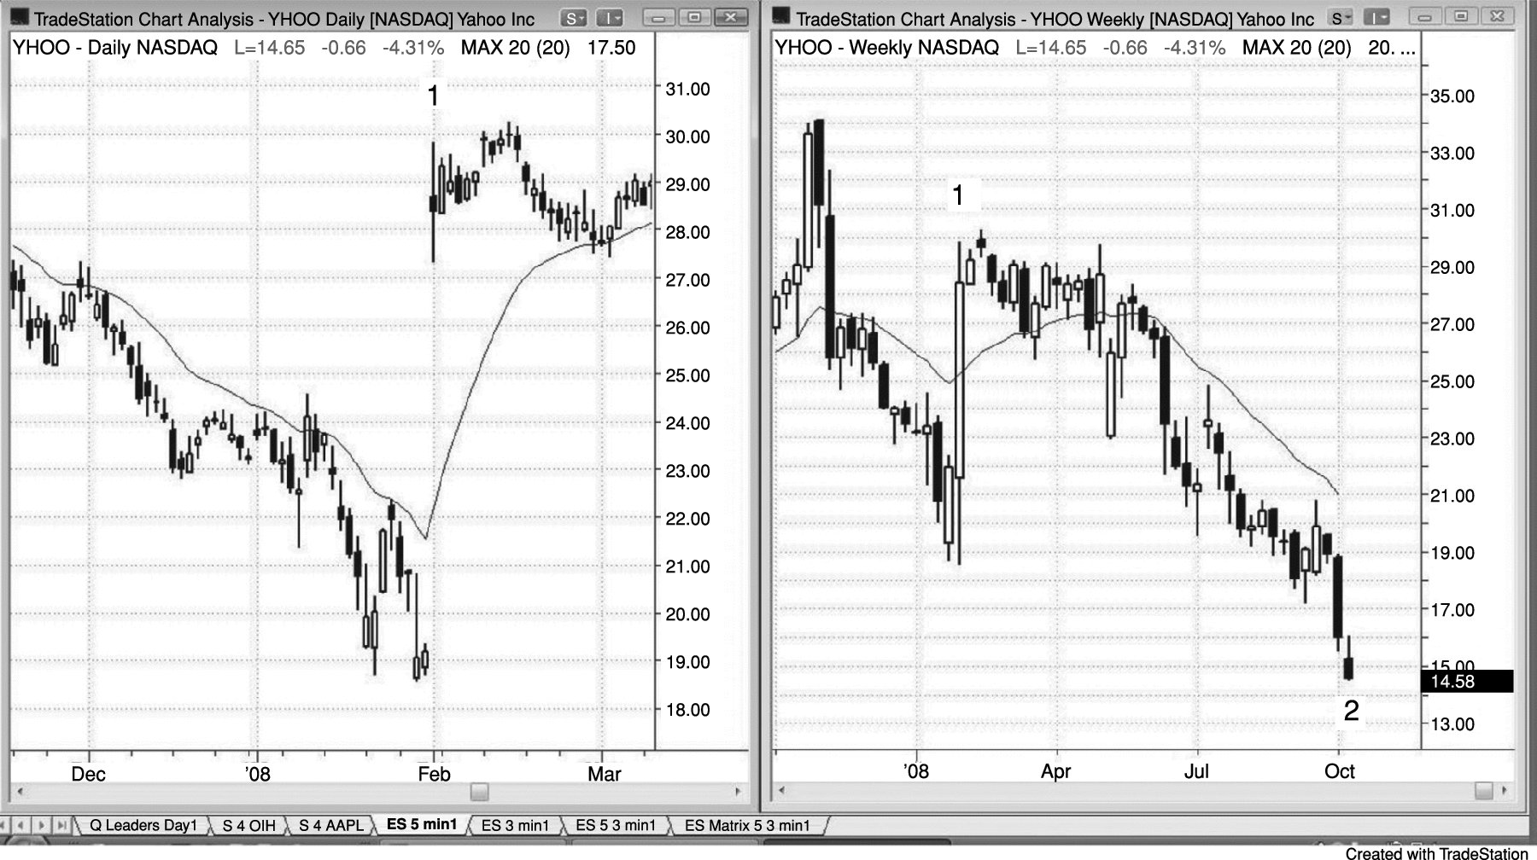
FIGURE I.3 Markets Can Fall on Bullish News

Slide 4
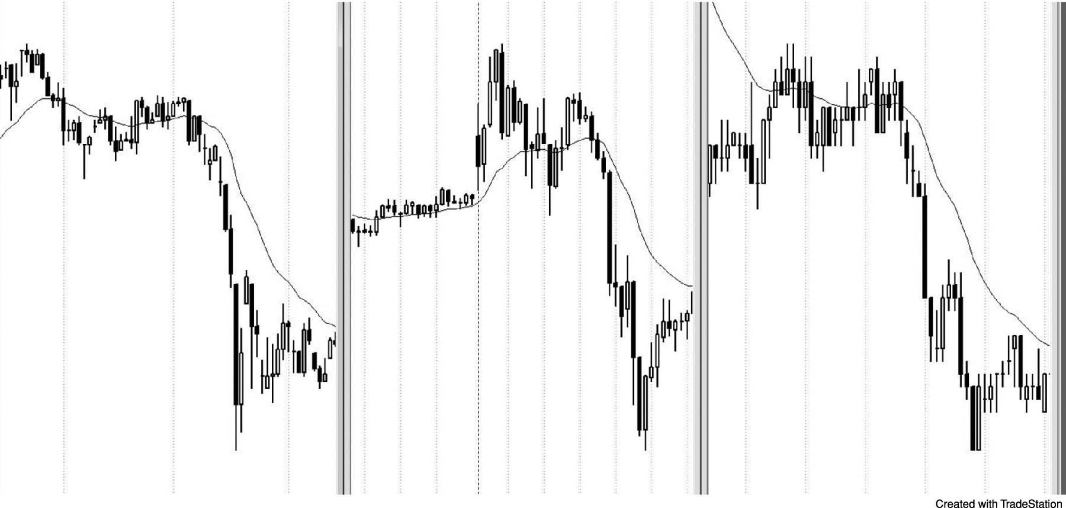
FIGURE I.4 Crashes Are Common

